Slide 1
How to blow up a state space using industrial control systems
James G. Wright

Slide 2
The plan
A brief history of symbolic analysis of security protocols
The Industrial Control Systems Problem
Examples of my work

Slide 3
The lineage of a problem

Slide 4
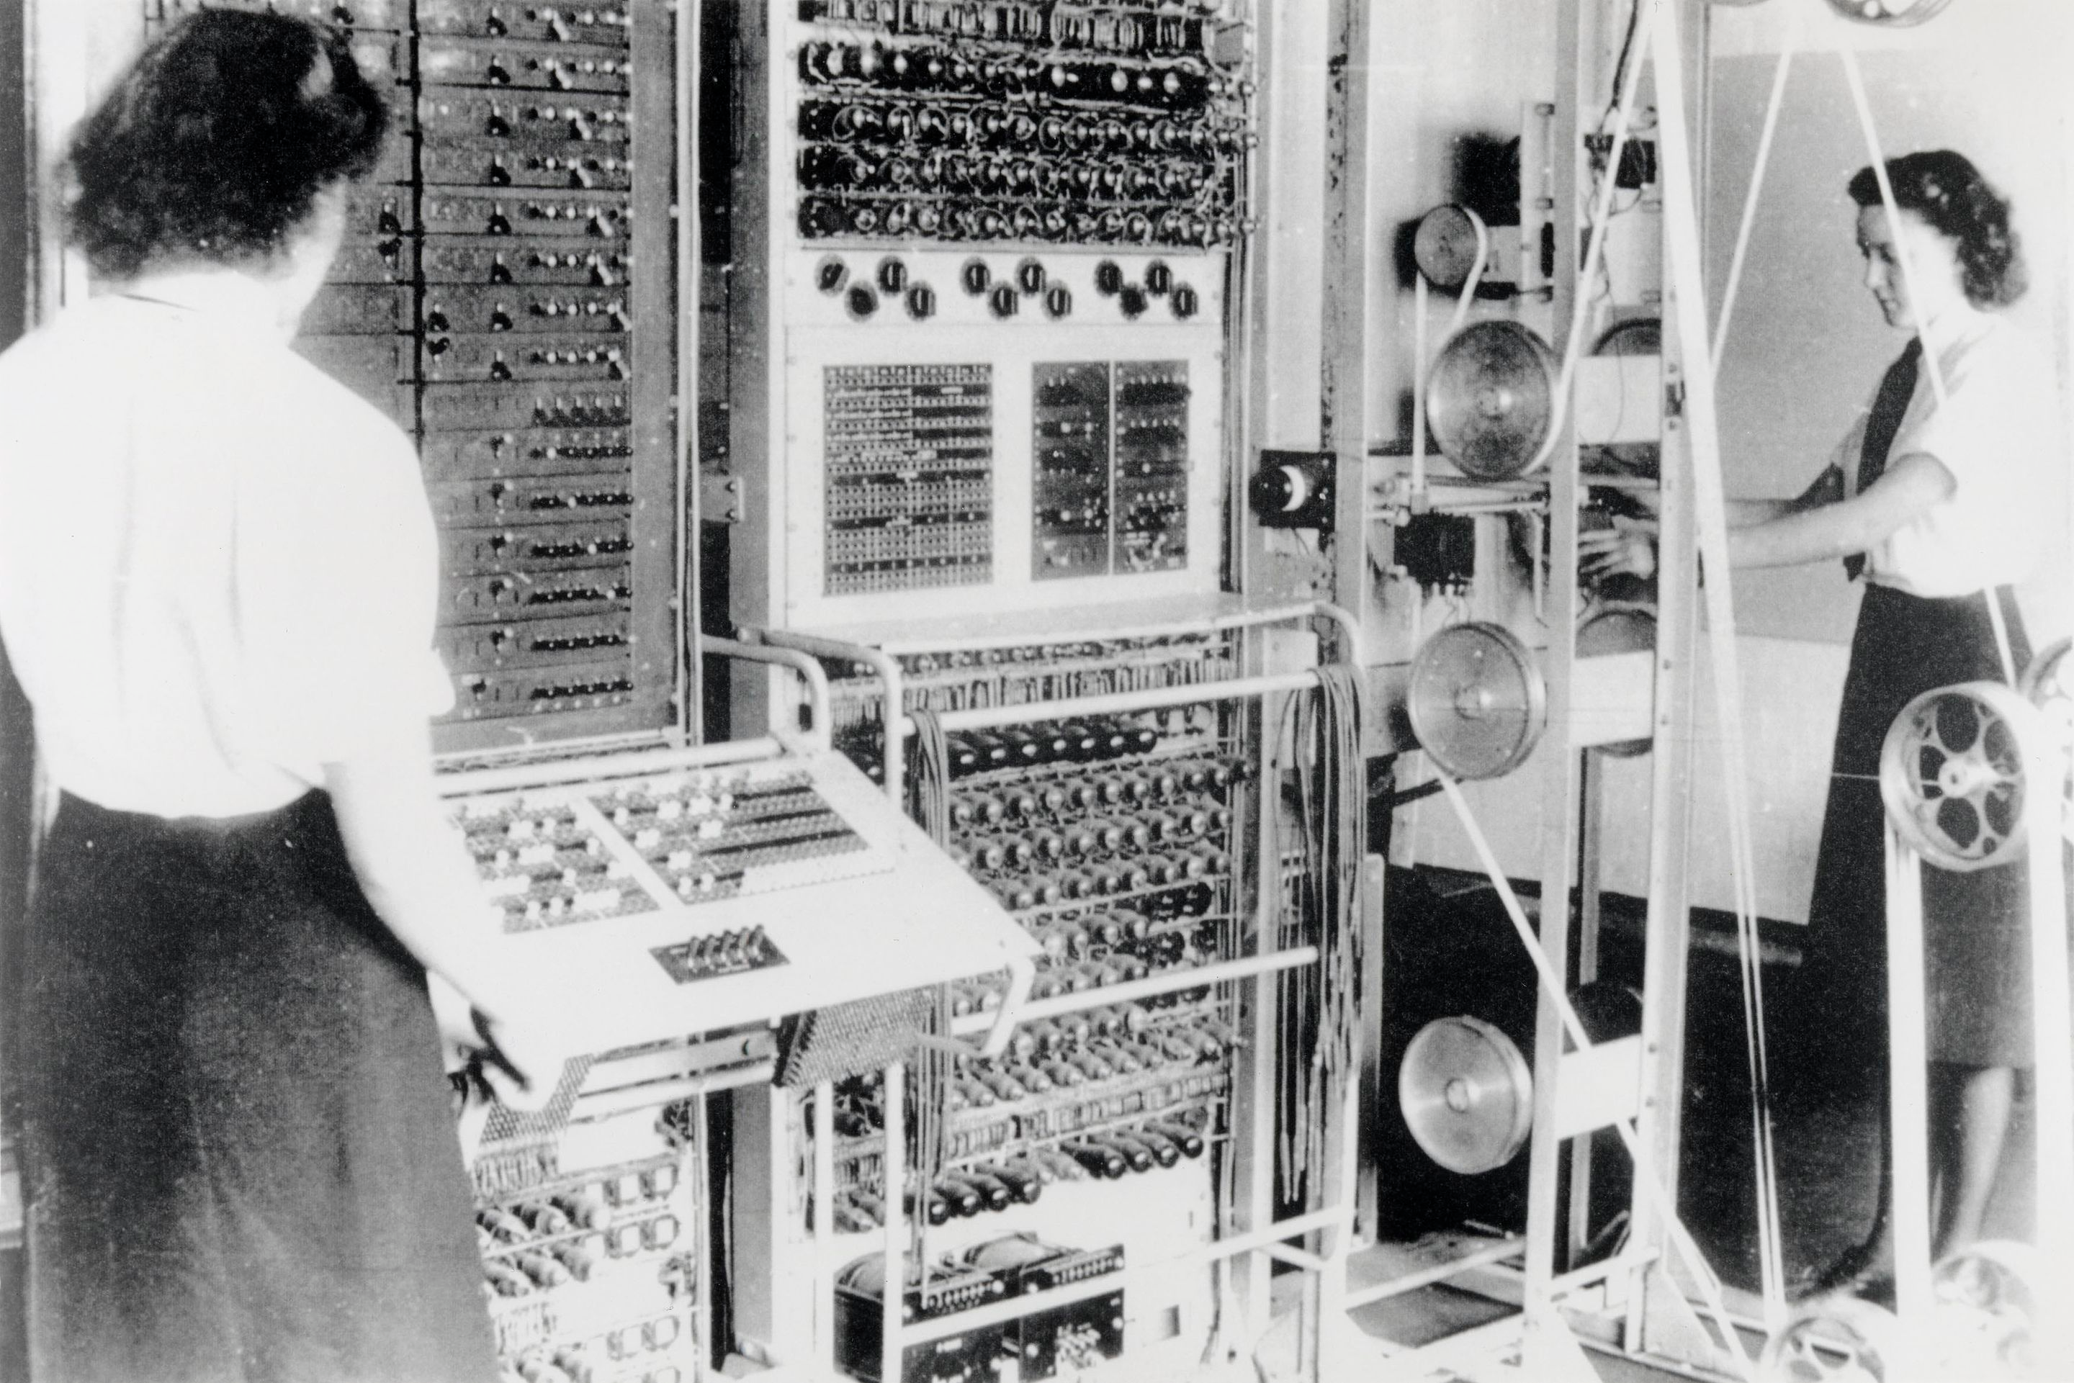
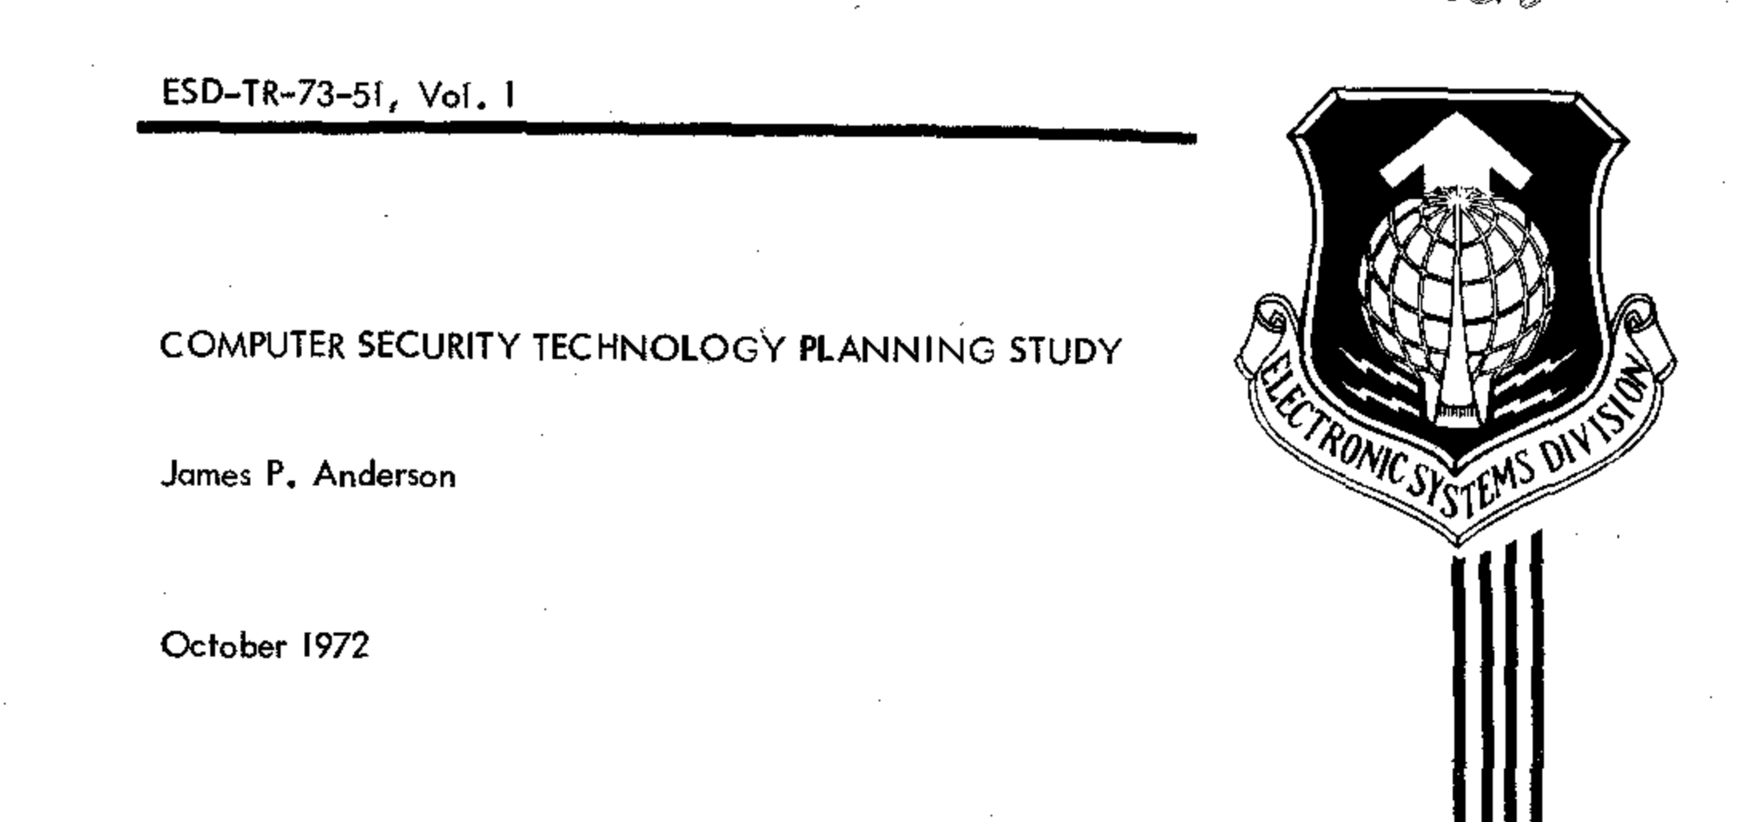
Where do we get our properties from?

Slide 5
The Emerging Divide

Slide 6
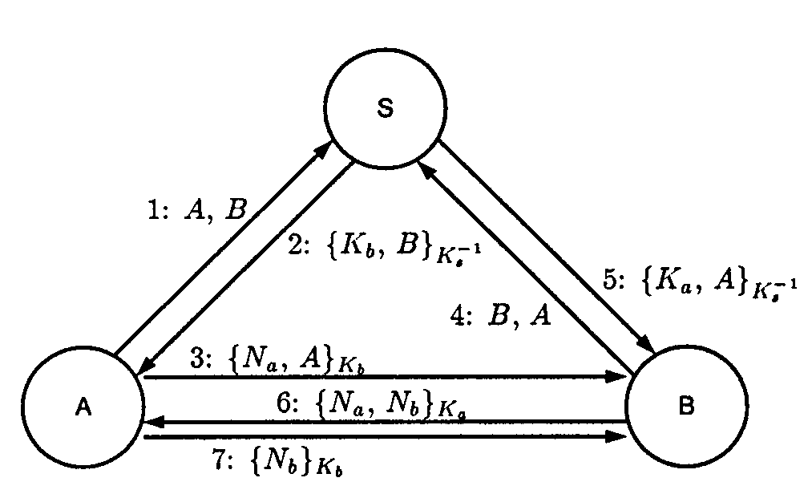
The symbolic school
Notes:
Confidentiality is NP-hard It has been shown that models need to be bounded to a limited number of sessions, with a finite set of agents, keys, and nonces for the problem to be decidable

Slide 7


The Refined Tools

Slide 8
Are we doing secure by design?

Slide 9
Industrial Control Systems

Slide 10
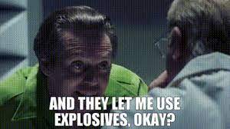

Slide 11
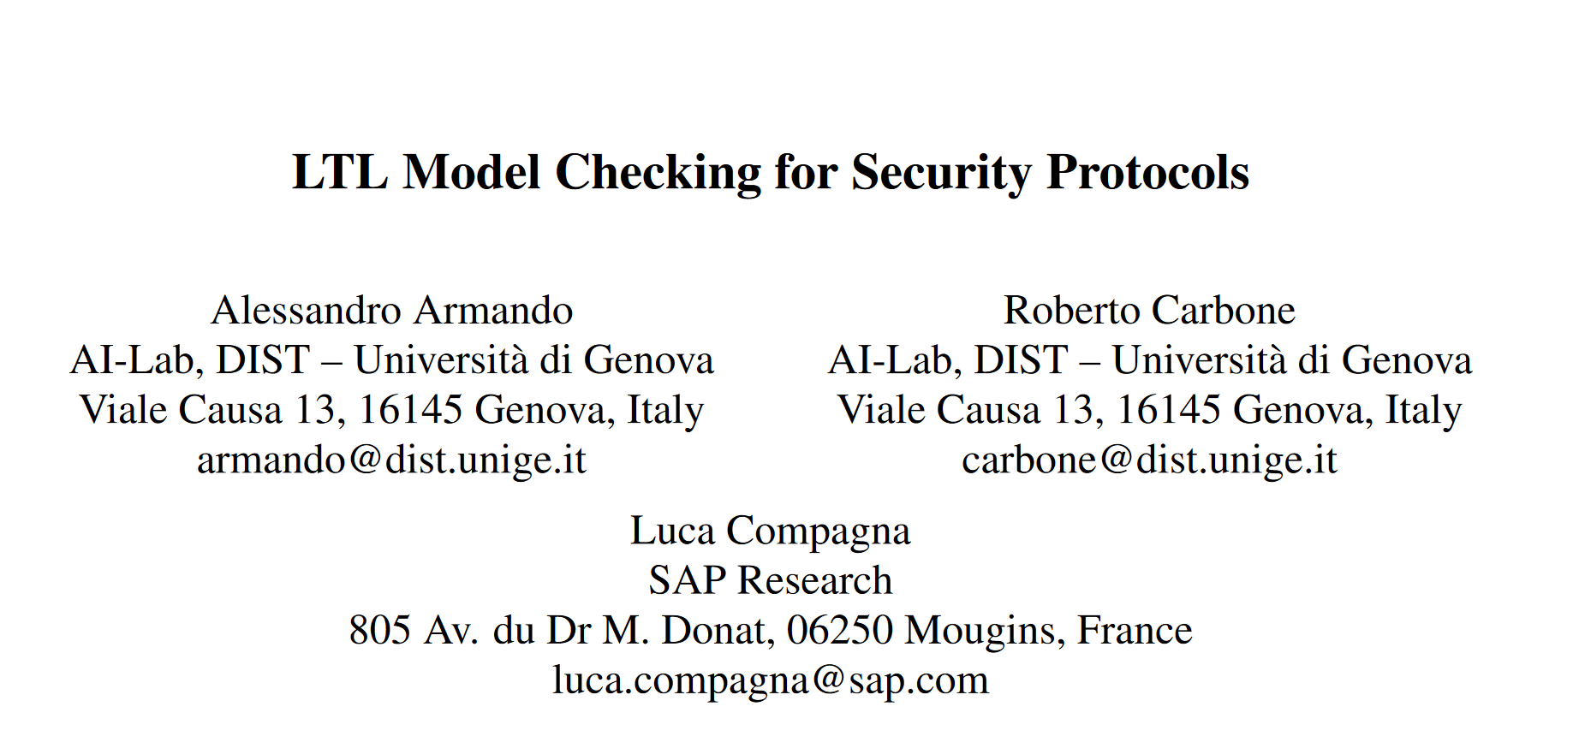
Verifying Against DoS

Slide 12
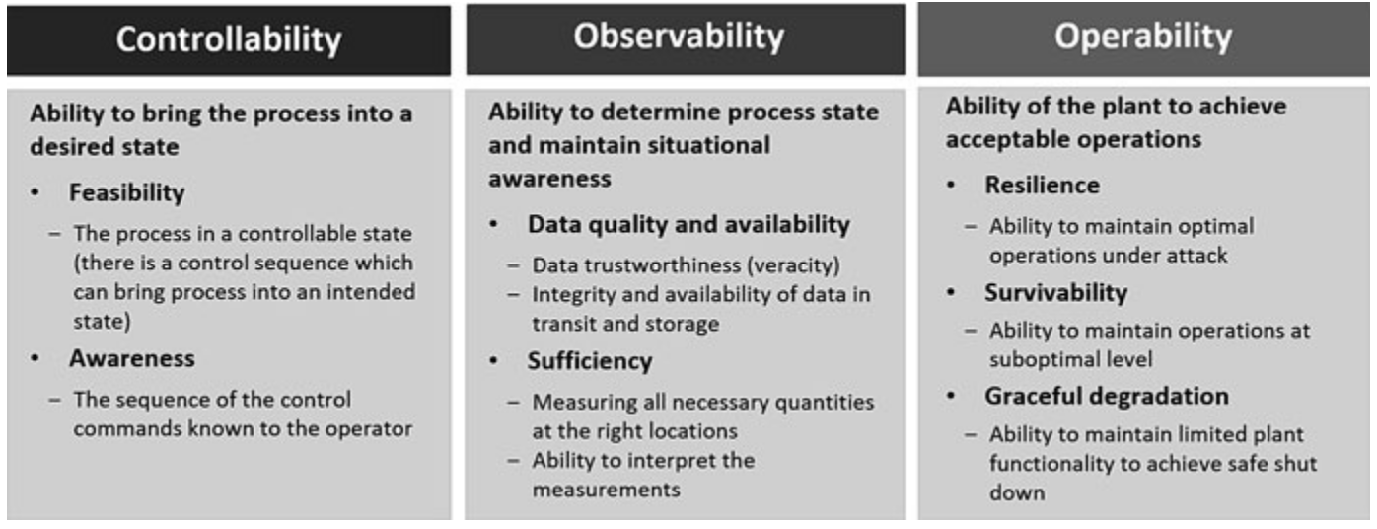
Why is this not good enough?
Notes:
Securing Industrial Control Systems Marina Krotofil, Klaus Kursawe, and Dieter Gollmann

Slide 13
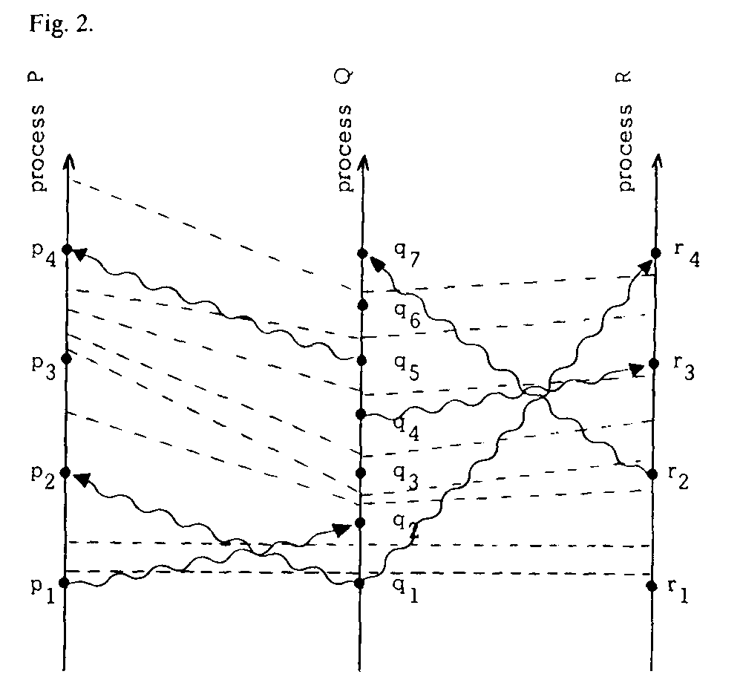
Why is it not good enough?
Notes:
Need to go HAM on the state space here

Slide 14
My work

Slide 15
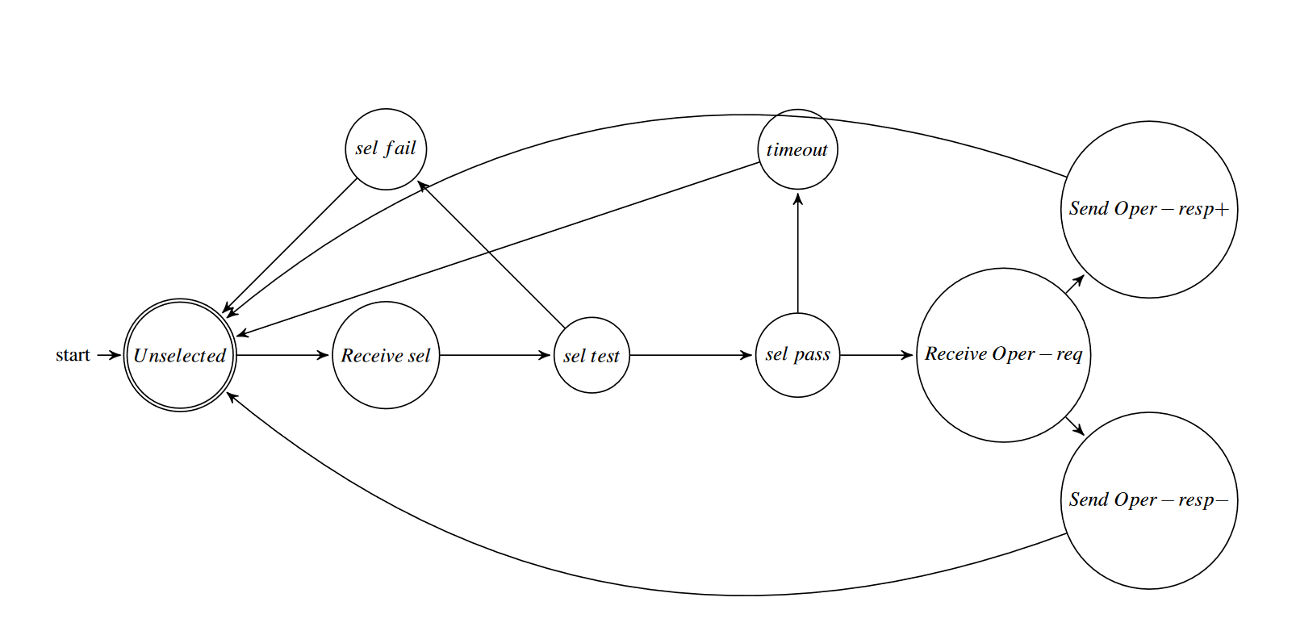
Manipulating frames and sessions

Slide 16
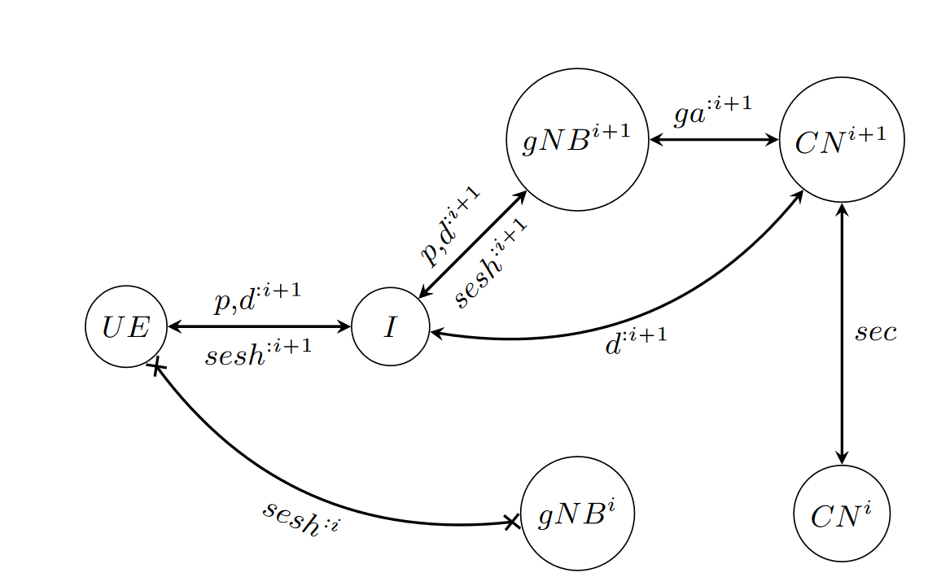
Increasing the number of agents

Slide 17
Concluding thoughts

Slide 18
Questions
James.g.wright@ntnu.no

